Slide 1
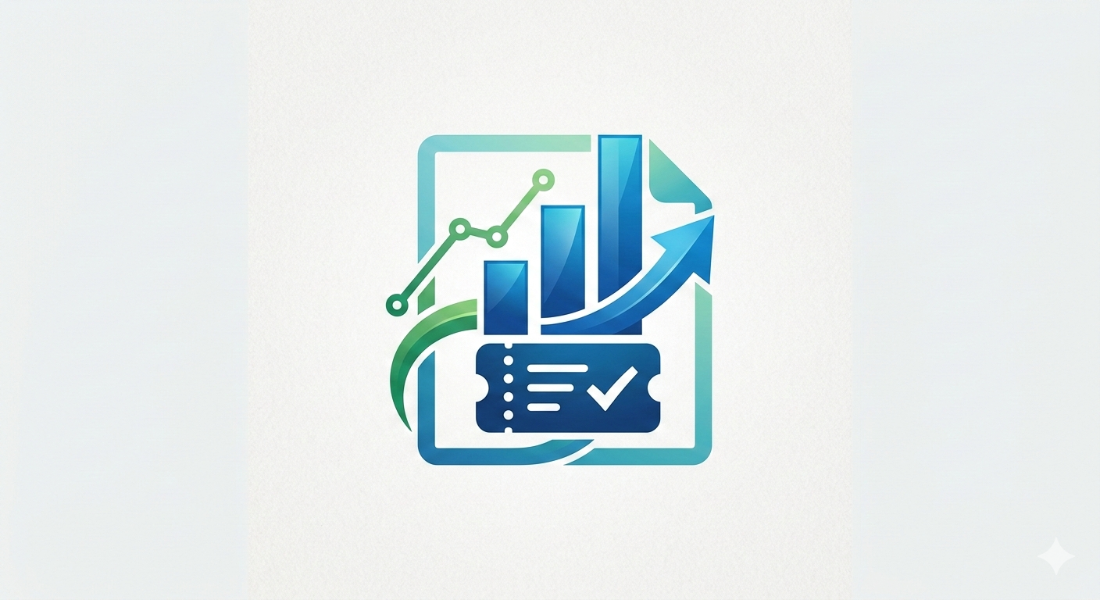
IT TICKET ANALYSIS
Sandeep Koduru

Slide 2
Introduction
In today’s organizations, IT support teams manage a high volume of service requests and incident tickets daily. These tickets include hardware failures, software issues, network problems, login/access errors, and system outages. Efficient tracking and analysis of these tickets are essential to ensure timely resolution and improved service quality.
The IT Ticket Analysis Excel Project focuses on analyzing IT support ticket data using Microsoft Excel. The project involves organizing raw ticket data, cleaning inconsistencies, and transforming it into meaningful insights using Excel tools such as formulas, Pivot Tables, charts, and dashboards.
Through structured analysis, the project helps monitor important service metrics like ticket volume, resolution time, priority levels, and technician performance. This enables better resource allocation, faster issue resolution, and data-driven decision-making within the IT support team.
This project demonstrates how Excel can be effectively used as a powerful data analysis and reporting tool in a real-world IT service environment.

Slide 3

Objectives
The main objectives of this project are:
• To organize and standardize raw IT ticket data for accurate analysis.
• To analyze ticket distribution based on categories, priorities, and status.
• To calculate key performance indicators (KPIs) such as:
Total number of tickets
Open vs. Closed tickets
Average resolution time
High-priority ticket count
• To evaluate technician workload and performance.
• To create Pivot Tables and Charts for visual representation of data.
• To design an interactive Excel dashboard for quick reporting and monitoring.
• To identify recurring technical issues and suggest improvement areas.

Slide 4
Data Overview
This report examines a dataset comprising 97,498 IT help desk tickets extracted from an internal service management system. The purpose of the analysis is to evaluate operational performance and identify recurring patterns within support activities.
The dataset consists of two main tables. The “Tickets Sheet” contains detailed records of all service requests, while the “IT Agents Sheet” provides background information about the support staff responsible for resolving those tickets.
The evaluation focuses on key metrics such as the “mean resolution time”, which stands at roughly 5 days, and employee satisfaction scores, measured on a five-point scale.
Workload analysis shows that the help desk receives an average of 53 new tickets per day, reflecting a stable and continuous demand for support services.
Each ticket is classified using multiple attributes, including Request Category (for example, Login Access or System-related issues), Issue Type, Severity Level, and Priority Level. This structured classification allows for a detailed examination of the types and urgency of issues reported.
By integrating the ticket records with agent details through the Agent ID, the analysis enables performance comparisons across agents and supports insights into how outcomes vary based on agent-specific characteristics.

Slide 5
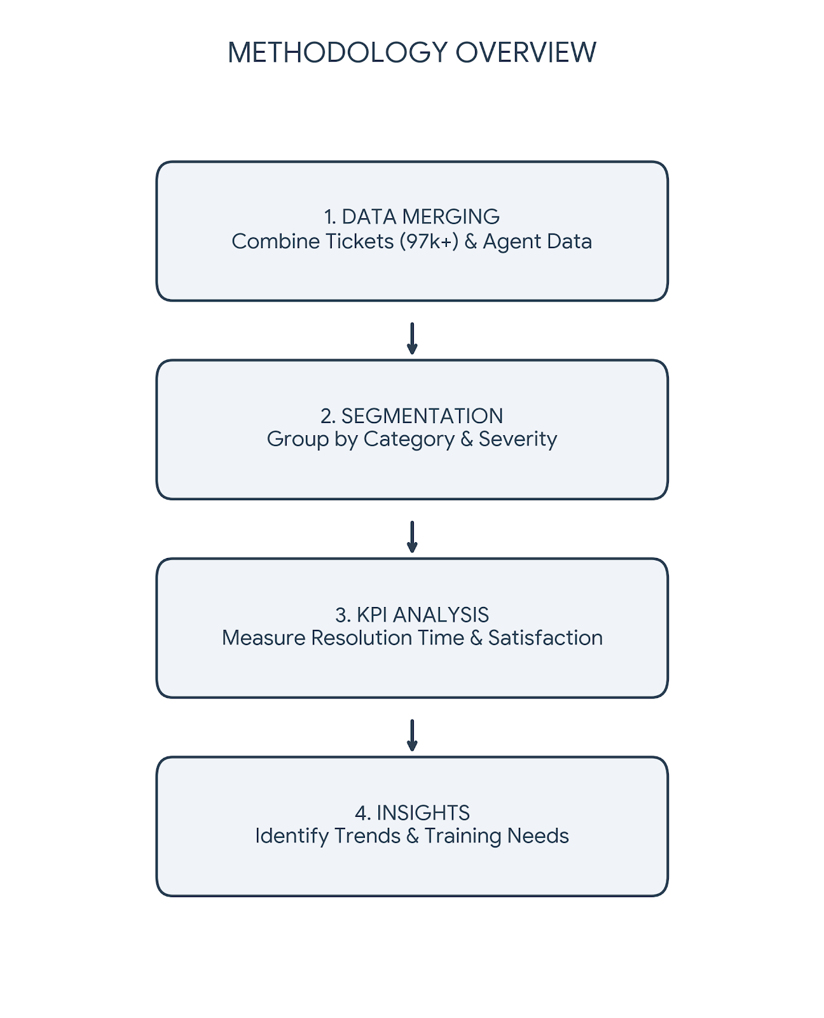
Methodology
Our analytical approach follows a top-to-bottom lifecycle:
I. Data Merging: Consolidating 97k+ tickets with 50 agent profiles via
Agent ID.
II. Segmentation: Slicing data by Category, Severity, and Priority.
III. KPI Analysis: Benchmarking Resolution Time, Satisfaction, and Daily
Volume.
IV. Strategic Insights: Forecasting peak periods and identifying
automation opportunities.

Slide 6
Volume & Satisfaction Trends
Ticket counts have nearly doubled from ~13K (2016) to ~29K (2020) over five years.
Growth has been consistent every year with no dips or plateaus.
The steepest jump occurred in 2019–2020, signaling accelerating demand.

Slide 7
Satisfaction rate has more than doubled from 51,939 (2016) to 121,043 (2020).
Growth remained steady year-over-year with no decline at any point.
The sharpest surge was in 2019–2020 (+32K), marking the biggest single-year leap.

Slide 8
Satisfaction is uniformly high across all age groups, ranging narrowly between 4.1–4.2.
The 50+ group is the most satisfied with the highest score of 4.2.
All groups aged 20–49 score equally at 4.1, showing no generational difference.
Severity & Satisfaction Distribution

Slide 9
High priority tickets lead at 35,549, signaling heavy critical workload.
Unassigned tickets (29,410) are concerningly high, indicating a triage gap.
Low and mid tickets are balanced at ~16K each.

Slide 10
Hardware is slowest to resolve (~30 days) across all quarters.
Login Access resolves almost instantly — under 1 day.
System and Software are mid-range at ~26 and ~21 days respectively.
Category & Resolution Breakdown

Slide 11
System tickets dominate at 39,002 — nearly 40% of all requests.
Login Access (29,193) is the second highest, indicating frequent access-related issues.
Hardware (9,733) is the least frequent, despite being the slowest to resolve.

Slide 12
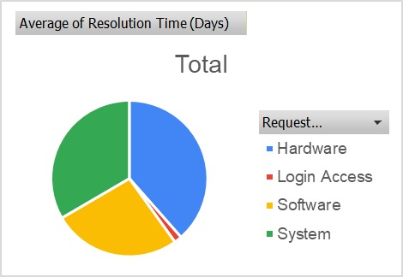
Resolution Time Analysis and Operational Bottlenecks
Hardware and System consume the most resolution time equally.
Software adds ~25% to the overall resolution burden.
Login Access is negligible — barely visible in the chart.

Slide 13
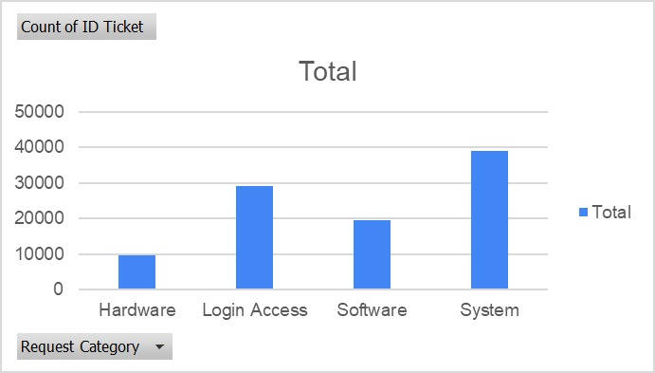
IT Ticket Volume Trends and Category Distribution Analysis
System leads with ~39K tickets — the highest volume category.
Login Access is second at ~29K, reflecting frequent access-related demands.
Hardware has the fewest tickets (~9K) despite its longest resolution time.

Slide 14

Strategic Recommendations
Cross-Generational Mentorship: Launch a formal pairing system where agents in the 40+ bracket mentor those in the 20–39 bracket on complex technical workflows. The goal is to reduce the 4.57-day resolution average among junior staff through direct knowledge sharing.
After the mentoring period, closely monitor their resolution times and satisfaction scores. If performance improves, the strategy can be reinforced; if not, additional one-on-one coaching may be required.
In addition, implement a mandatory, targeted training program for these specific agents, focusing on advanced troubleshooting techniques and customer communication skills. This directly addresses the identified weaknesses in efficiency and service quality, ensuring that resources are used in a focused and impactful manner.

Slide 15
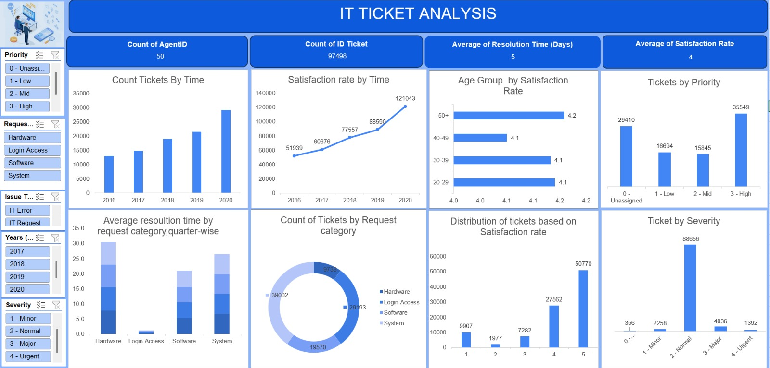
Dashboards & Visualisations

Slide 16


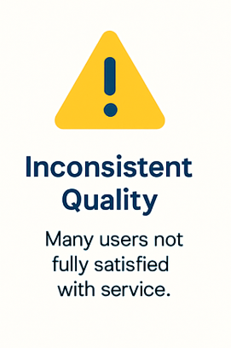
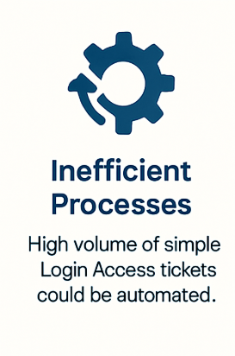
Summary Of Key Finding

Slide 17
Conclusions
The IT support team is effectively coping with a steadily increasing workload. Although ticket volumes have nearly tripled over the past five years, the team continues to close a strong percentage of requests quickly and has maintained a gradual rise in satisfaction ratings year after year.
Service quality remains generally strong, but some inconsistencies are evident. While many users award the highest rating (5 out of 5), a considerable share of tickets receive ratings as low as 2 or below. This variation suggests a need to streamline processes and deliver a more consistent support experience across all cases.
Certain ticket categories are slowing down overall performance. Specifically, "Hardware-related issues" and “Login Access requests” take approximately 7–9 days on average to resolve, compared to faster resolution times in other areas. These segments clearly require focused process improvements to enhance efficiency.
User satisfaction also varies across age groups and issue categories. Employees aged "22–30" and those above "55" report the highest satisfaction levels, while individuals in the "30–45" age range show comparatively lower ratings. This indicates that support approaches may need to be better customized to meet the expectations of this key working-age group.

